Slide 1

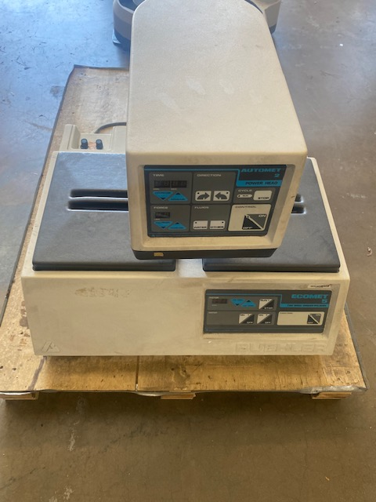
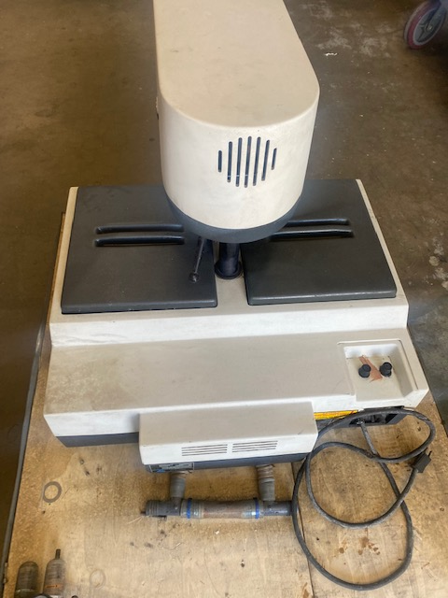
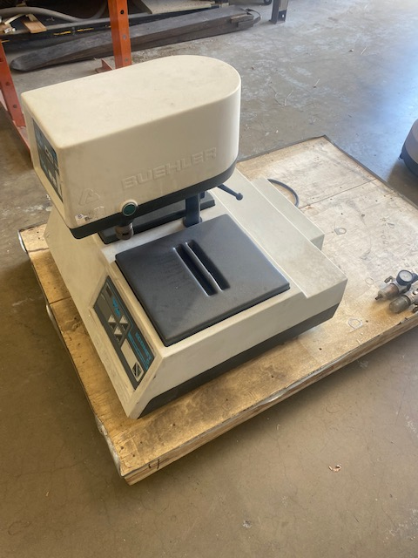
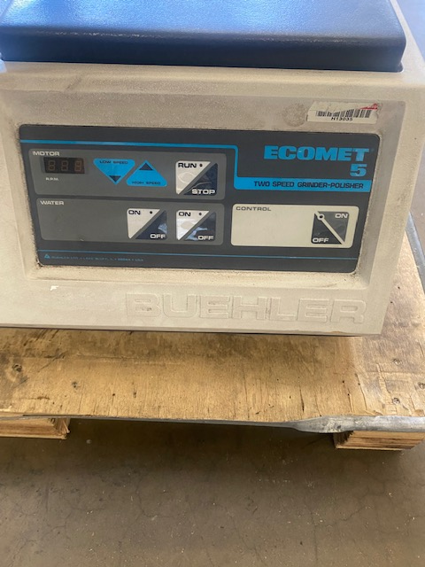
BUEHLER ECOMET 5
Grinder/Polisher with 5 variables speed polisher tabletop and two speed grinder, should you have any questions, call for
More information at 714-541-9600.
283 Winfield Circle, Corona, CA. 92878 • Toll Free (877) 773-4567 • Local (714) 541-9600

