Slide 1
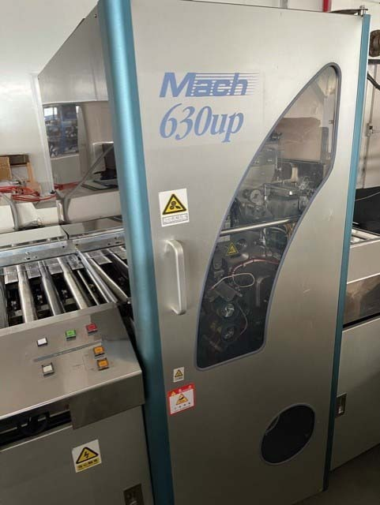
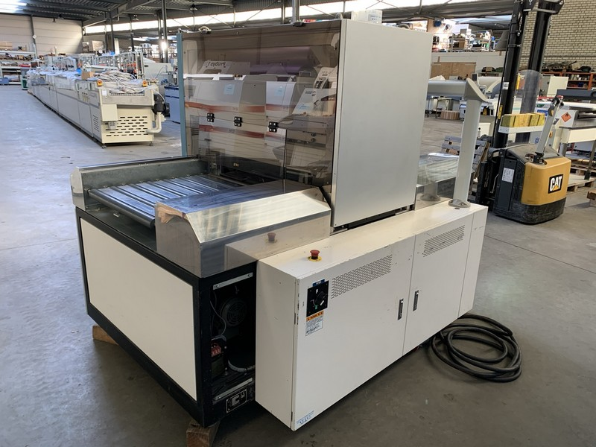
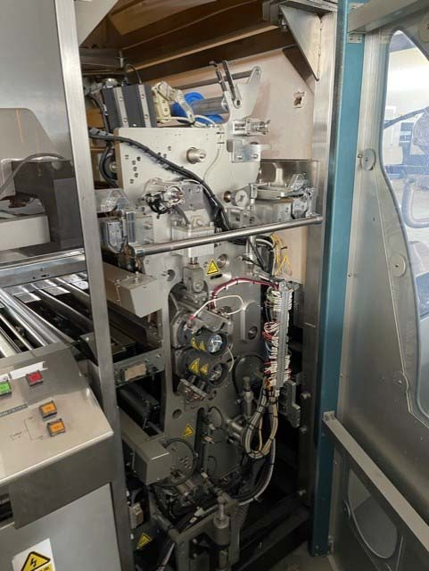
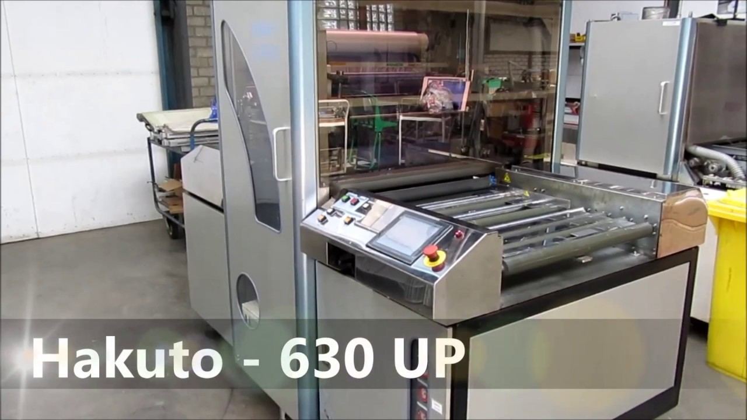
Hakuto Mach 630up
These are stock images while our machine is being refurbished. Check back soon to see the actual photos of the unit we will have ready for you!
283 Winfield Circle, Corona, CA. 92878 • Toll Free (877) 773-4567 • Local (714) 541-9600

